Slide 1
COMP 53 – Week Thirteen
GUI

Slide 2
Topics
Midterm Review
What is Event Driven Programming?
Intro to C#
Custom Data Structures in C#
Notes:
Typical Lesson Plan
Monday
Hand back midterms – 15 minutes to review
Wrap up with Intro to c# and discuss declarative programming
Wed
Completed the MPG in class exercise (45 minutes)
Start Lab 10.
Fri
Complete lab 10
Monday
Complete the Dilbert practice code (45 minutes )
Start Lab 11. Most students were able to get the basic form structure created and copy code from instruction
Wed – Complete Lab 11. (if needed)

Slide 3
Why Do We Care
Because GUI is more fun!
Most applications for phones, web, MacOS, Windows all leverage GUI libraries
Leverage other people’s stuff – huge value in built in libraries

Slide 4
Console Based Programming
There is just one event – program launch
Everything else is procedural - from top to bottom
Menu Systems provide some level of event processing
User can choose any option on the menu
Program responds to user input

Slide 5
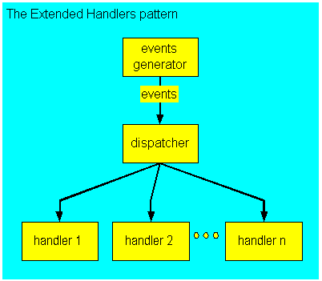

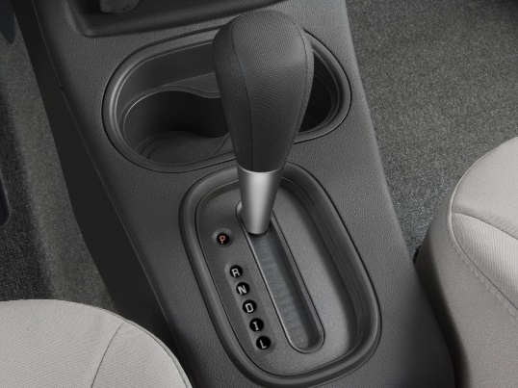
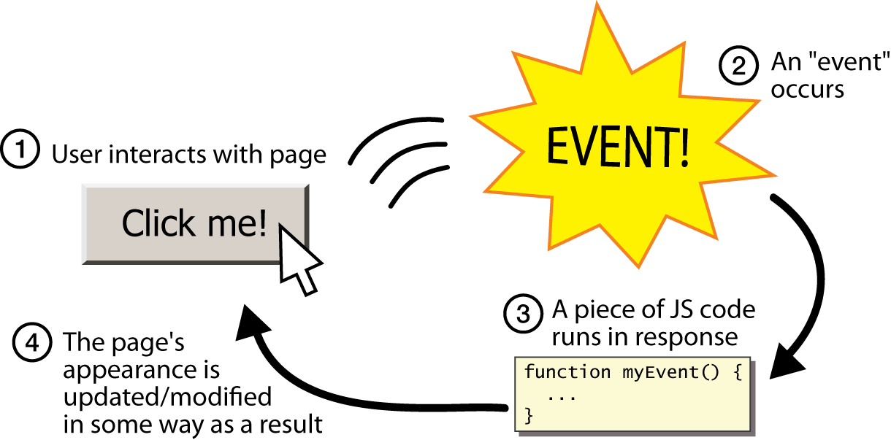
Multi-Event Driven Programming
Dispatcher acts as gear shifter

Slide 6
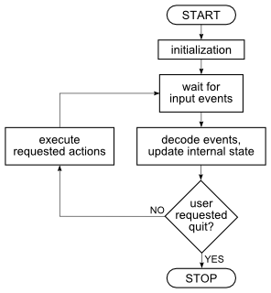
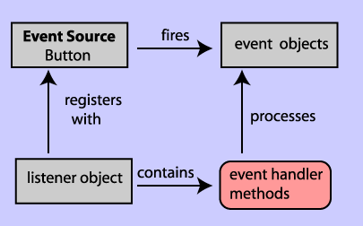
Event Program Flow

Slide 7
Model-View-Controller Pattern Facebook Login Example
Generic Design Pattern – any application and platform
Way of dividing I/O task out
Model part: heart of application
View part: output
Displays picture of model’s state
Controller part: input
Relays commands from user to model
A divide and conquer strategy
One big task → three smaller tasks
Each with well-defined responsibilities
Notes:
Start video at 2:45-4:00

Slide 8
Simplified View of Browser Page
Browser Page Request
Web Server Script
Data Base Storage
HTML over HTTP
SQL & C++
User initiates the event by clicking on button or link

Slide 9
MVC Diagram Details
Model takes care of the data
Apply functional logic
User Request
Page Request
Controller
Model
Request for data
Data Base Storage
Display specific format
Final Data Results
View
SQL or DBMS Specific Code
Determine which presentation format to use – HTML, iOs or Windows

Slide 10
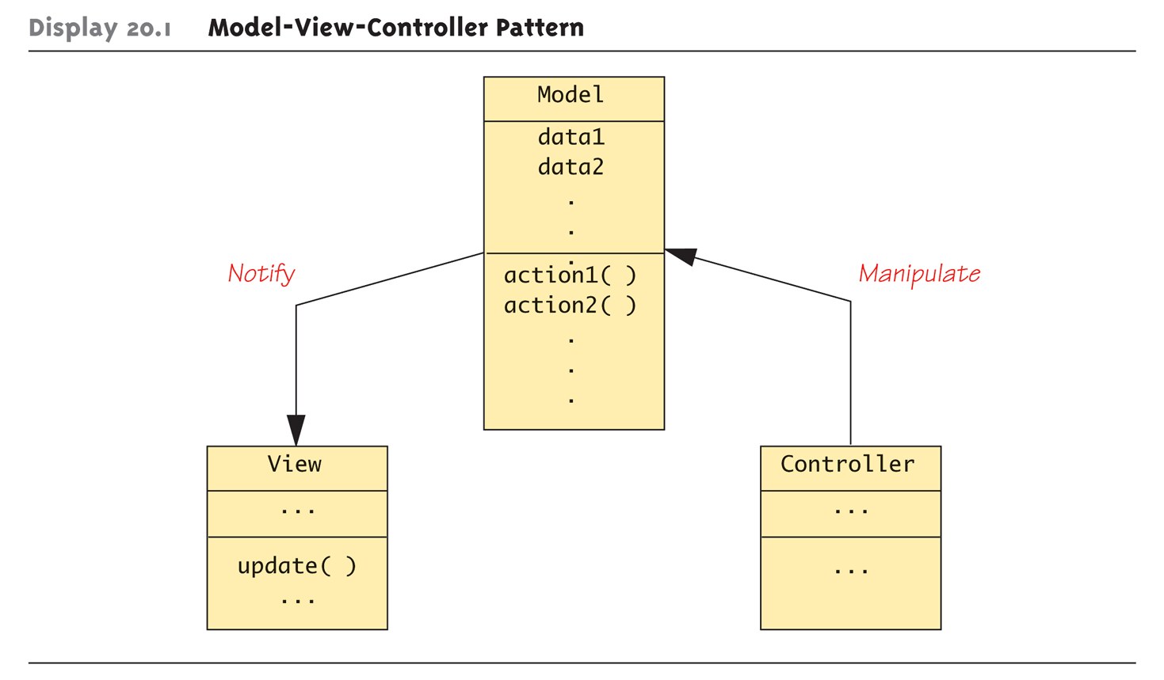
Model-View-Controller Object Pattern
Good News! The controller object is already provided in Windows

Slide 11
Topics
What is Event Driven Programming?
Intro to C#
Custom Data Structures in C#

Slide 12
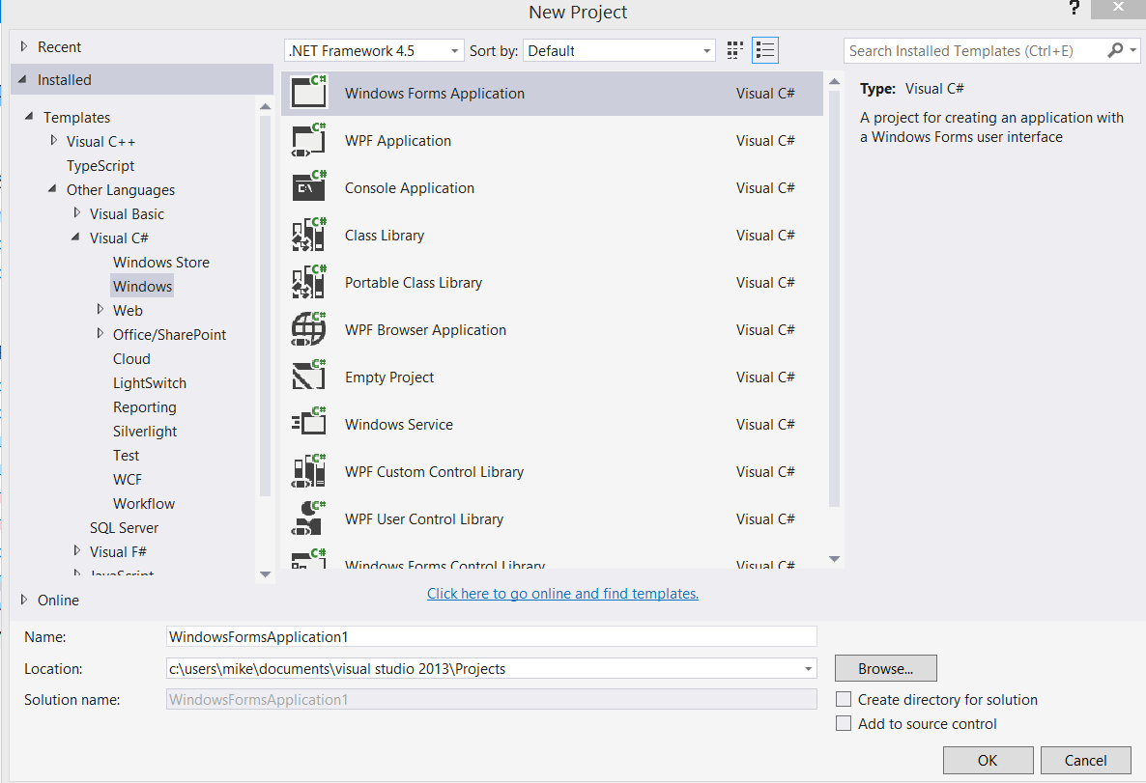
Create First C# Project
Choose Visual C# → Windows
Choose Windows Forms App

Slide 13
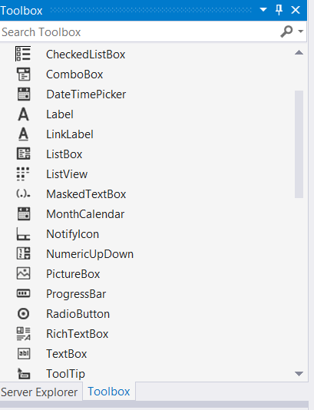
Add Text Boxes
Provide Prompts – Add Labels
In Text property - Type Name and Address
In Name property – type labelName and labelAddress
Add the following text boxes
Text Property – blank
Name Property – textName and textAddress
Drag a text box onto the page

Slide 14
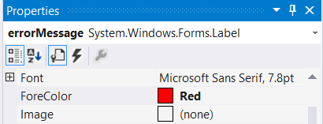
Setting Fields and Labels Fonts
Make Name bold.
Find the Font category and expand this
Set Bold to True
Drag a Label to the bottom of the page
Set Name = errorMessage
Blank out the text
Set the foreground color to red

Slide 15

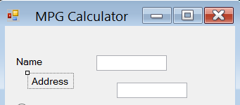
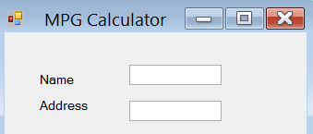
Making Things Look Pretty
Play with alignment options to get controls lined up
Draw a rectangle around the text boxes

Slide 16
Declarative Programming
Tell Computer/Compiler what the application should do, not how it should do it
Leverage IDE to actually execute the instructions
Use built in tools to design your program
Assemble building blocks into functional programs
Minimize coding!

Slide 17
Adding Your Code
GUI applications are event-driven which means they interact with users
An event is a user’s action such as mouse clicking, key pressing, etc.
Double clicking a control, such as Button, will link the control to a default Event Handler
An event handler is a method that executes when a specific event takes place
A code segment similar to the following will be created automatically:
private void myButton_Click(object sender, EventArgs e)
{
}

Slide 18
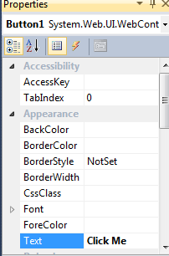
Add an Action - Button
Drag a Button onto bottom of page
Change Text = Click Me
Double click on the button (or press enter)
This should create a new tab/page called form1.cs
In the method Button1_Click, type:
errorMessage.Text = "Thanks for clicking";
Try it out → Press play button!

Slide 19
Message Boxes
A message box (aka dialog box) displays a message
The .NET Framework provides a method named MessageBox.Show
C# can use it to pop up a window and display a message. A sample code is (bold line):
private void button1_Click(object sender, EventArgs e)
{
MessageBox.Show(“Thanks for clicking the button!”);
}
Notes:
This is only for Windows forms.

Slide 20
Convert String to Numeric Values
Input collected from the keyboard are considered combinations of characters (or string literals) even if they look like a number to you
A TextBox control reads keyboard input, such as 25.65. However, the TextBox treats it as a string, not a number.
In C#, use the following Parse methods to convert string to numeric data types
int.Parse
double.Parse
decimal.Parse
Examples:
int hoursWorked = int.Parse(hoursWorkedTextBox1.Text);
double temperature = double.Parse(temperatureTextBox.Text);
Notice that int and double are now class definitions

Slide 21
Convert Numeric to String Values
The Text property of a control only accepts string literals
To display a number in a TextBox or Label control requires you to convert a numeric data to string type
In C#, all variables work with ToString method that can convert variables’ values to string:
Double grossPay = 1550.0;
grossPayLabel.Text = grossPay.ToString();
int myNumber = 123;
MessageBox.Show(myNumber.ToString());
Another option is “implicit string conversion with the + operator”:
int idNumber = 1044;
String output = “Your ID number is “ + idNumber;
This is an example of operator overloading

Slide 22
Formatting Numbers
The ToString method can optionally format a number to appear in a specific way
The following table lists the “format strings” and how they work with sample outputs
Format String | Description | Number | ToString() | Result
“N” or “n” | Number format | 12.3 | ToString(“n3”) | 12.300
“F” or “f” | Fixed-point scientific format | 123456.0 | ToString("f2") | 123456.00
“E” or “e” | Exponential scientific format | 123456.0 | ToString("e3") | 1.235e+005
“C” or “c” | Currency format | -1234567.8 | ToString("C") | ($1,234,567.80)
“P” or “p” | Percentage format | .234 | ToString("P") | 23.40%

Slide 23
Exception Handling
An exception is an unexpected error that happens while a program is running
If an exception is not handled by the program, the program will abruptly halt
C# allows you to write codes that responds to exceptions. Such codes are known as exception handlers.
In C# the structure is called a try-catch statement
try { }
catch { }
The try block is where you place the statements that could have exception
The catch block is where you place statements as response to the exception when it happens

Slide 24
Calculate MPG Practice
Add three more text boxes to page
Miles, gallons, mileage
Change the mileage to display only
Set Read Only = true
Change button text = “Calculate Mileage”
Update Code - Switch back to your form.cs file
Copy/Paste code in the notes below
Make sure to match IDs to match code in notes section.
Remove the previous errorMessage code and Message box code
Paste the code from the notes below
Notes:
try
{
double miles;
double gallons;
double mpg;
miles = double.Parse(textMiles.Text);
gallons = double.Parse(textGallons.Text);
mpg = miles / gallons;
textMPG.Text = mpg.ToString();
}
catch
{
errorMessage.Text = "Need to provide a value for Gallons";
MessageBox.Show("Need to provide a value for Gallons");
}

Slide 25
Throwing an Exception
In the following example, the user may entered invalid data (e.g. null) to the milesText control. In this case, an exception happens (which is commonly said to “throw an exception”).
The program then jumps to the catch block.
You can use the following
to display an exception’s
default error message:
catch (Exception ex)
{
MessageBox.Show(ex.Message);
}
try
{
double miles;
double gallons;
double mpg;
miles = double.Parse(milesTextBox.Text);
gallons = double.Parse(gallonsTextBox.Text);
mpg = miles / gallons;
mpgLabel.Text = mpg.ToString();
}
catch
{
MessageBox.Show("Invalid data was entered."):
}

Slide 26
Preventing Data Conversion Exception
Exception should be prevented when possible
The TryParse methods can prevent exceptions caused by users entering invalid data
int.TryParse
double.TryParse
decimal.TryParse
The generic syntax is:
int.TryParse(string, out targetVariable)
The out keyword is required; it specifies that the targetVariable is an output variable

Slide 27
Samples of TryParse Methods
// int.TryParse
int number;
if (int.TryParse(inputTextBox.Text, out number)) { } else { }
//double.TryParse
double number;
if (double.TryParse(inputTextBox.Text, out number)) { } else { }
//decimal.TryParse
decimal number;
if (decimal.TryParse(inputTextBox.Text, out number)) { } else { }

Slide 28

RadioButton Control
Ability to turn off/on selections
Common properties are:
Text: holds the text that is displayed next to the radio button
Checked: a Boolean property that determines whether the control is selected or deselected
Tag: User defined data value
In code, use a decision structure to determine whether a RadioButton is selected. For example,
If (choiceRadioButton.Checked) { } else { }

Slide 29
Add Radio Buttons to Form
After the Address field, insert a few blank lines
Drag three RadioButton controls to the blank space
The tag value will represent the gas tank size for the vehicle you choose
Set properties for each:
Name = radioCar1, radioCar2, radioCar3
Text = <your favorite card>
Tag = <gas tank size>
Make gallons text box display only

Slide 30
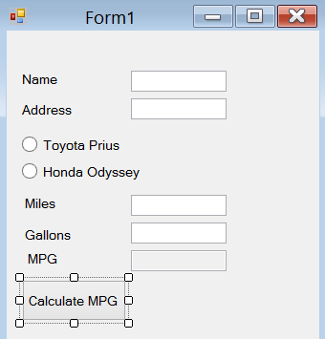
Accessing Selected Radio Logic
Add if statements for each radio button
If the checked flag is true
Update the textGallons.text with the tag value.
Make sure to do this prior to the gallons assignment

Slide 31

CheckBox Control
The CheckBox Control gives the user an option, such as true/false or yes/no
Common properties are:
Text: holds the text that is displayed next to the radio button
Checked: a Boolean property that determines whether the control is selected or deselected
In code, use a decision structure to determine whether a CheckBox is selected. For example,
If (option1CheckBox.Checked) { } else { }
Notes:
Anything a RadioButton or a CheckBox control’s Checked property changes, a CheckedChanged event is raised
You can create a CheckedChanged event handler and write codes to respond to the event
Double click the control in the Designer to create an empty CheckedChanged event handler similar to:
private void yellowRadioButton_CheckedChanged(object sender, EventArgs e) { }

Slide 32
Topics
What is Event Driven Programming?
Intro to C#
Custom Data Structures in C#

Slide 33
Declaring Custom Method Inside a Class
using System;
using System.Collections.Generic;
using System.ComponentModel;
using System.Data;
using System.Drawing;
using System.Linq;
using System.Text;
using System.Windows.Forms;
namespace Example
{
public partial class Form1 : Form
{
public Form1()
{
InitializeComponent();
}
// your method definition will appear here inside Form1 class
}
}
All Visual C# methods typically belong to applications’ default namespace
private void goButton_Click(object sender, EventArgs e)
{
MessageBox.Show(“This is the goButton_Click method.”);
DisplayMessage();
}
private DisplayMessage()
{
MessageBox.Show(“This is the DisplayMessage method.”);
}
Method call

Slide 34
Passing Arguments by Reference
Concept same as C++
A reference parameter is a special type of parameter
It becomes a reference to the argument that was passed into it
When an argument is passed by reference to a method, the method can change the value of the argument in the calling part of the program
In C#, you use the ref keyword before the parameter variable’s data type
private void SetToZero(ref int number)
{
number =0;
}
To call a method with a reference parameter, you also use the keyword ref before the argument
int myVar = 99;
SetToZero(ref myVar);

Slide 35
Using Output Parameters
An output parameter works like a reference parameter with the following differences:
An argument does not have to be initialized before it is passed into an output parameter
A method that has an output parameter must be the output parameter to some value before it finishes executing
In C#, you use the out keyword before the parameter variable’s data type
private void SetToZero(out int number)
{
number = 0;
}
To call a method that has a output parameter, you also use the keyword out before the argument
int myVar;
SetToZero(out myVar);
Uninitialized variable

Slide 36
Working with Resources
Resources are pre-built objects that can be included with your delivered code. Examples
Pictures
Data Files
Strings – Used for language conversion
Icons
Audio Files
Navigate : Project → <current project> Properties. Click on Resources
Drag and drop photos into resources.

Slide 37
Arrays in C#
Syntax changes
1-D : <type>[ ] name = new <type>[SIZE] {…}
2-D : <type>[, ] matrix = new <type>[D1, D2]
3-D : <type>[, , ] space =
Examples
string[] pixArray = new string [6] {"dt000221", "dt000317", "dt000327", "dt000329", "dt000415", "dt140221"};
int[] array = new int[5];

Slide 38
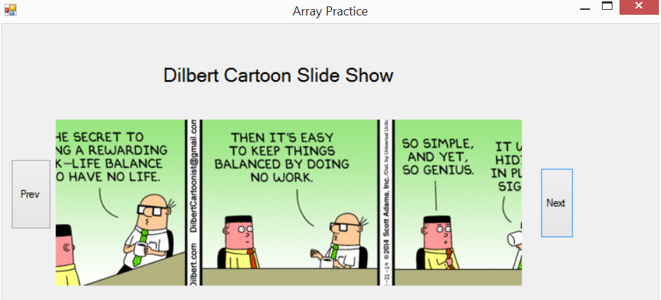
Array Practice (1 of 2)
Create a new C# windows project – Array Practice
Download the image zip file from Sakai
Drag these images into the project resources dialog
Navigate : Project → Properties
Click on Resources tab (link)
Drag the following controls to the form
Button 1 – Name this Prev
Buttion 2 – Name this next
Picture Box

Slide 39
Array Practice (2 of 2)
In the Form class define an array of strings (size 5)
Initialize the strings to the names of the resources
Declare an integer which represents the index into the array which will display the corresponding image
Double click on the previous button to create a method
Decrement the index, but make sure it does not go below 0
Add code to update the picture box Image property with the image to be displayed. (Image)TestGUICS.Properties.Resources.ResourceManager.GetObject(pixArray[pixCtr])
Double click on the next button to create a method
Repeat the steps from the previous button but increment index
Bonus – Which method should be used to set the initial image
Play with sizemode property to get images to fit the picture box

Slide 40
And Life Gets Easy!
Built in Data Structures
Hashtables
Queues
Stacks
Sorted Lists
Check out the system.collections class
All of typical operations are already built for you

Slide 41
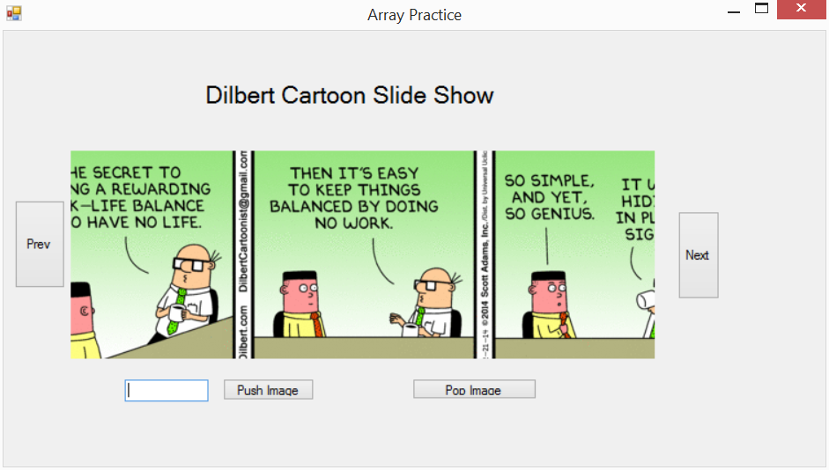
Stack Practice
Add a text box to the form
Add two buttons
Name = buttonPush – Text = Push Image
Name = buttonPop – Text = Pop Image
Add a stack variable – place in the form class definition
Stack pixStack = new Stack();
Double click on the Push button to create the method
Add code to push the value that’s in the textbox to the stack
Make sure to verify that the textbox is not empty
Reset the textbox to empty after the push
Double click on the Pop button to create the method
Pop the top value from the stack
Use this string to set the image name and display
Notice the similarity to array definition

Slide 42
Key Takeaways
Event driven programming can be both complex and simple!
Complex libraries to learn
New paradigm of program flow
Simple field updates and powerful data management
C#
Variant of C++ with a focus on GUI development
No main() function
Nested methods and functions
Everything is an object! Including int, double, etc.

